Slide 1


Cyber law and Professional Ethics
Unit- 2
Cyberattacks, ……
Compiled by:
Khagaraj Paneru

Slide 2
Threat Landscape
The threat landscape refers to the range of risks and dangers that companies face regarding the security of their data and information systems.
This includes safeguarding confidential business information, as well as the private data of customers and employees, from theft, disruption, and other malicious acts.
While maintaining security is crucial, businesses often need to balance security measures with other business needs, leading to complex decisions. For example, companies must decide how much money and effort to invest in security to feel “safe enough” and consider how strict security rules might impact customer convenience or employee efficiency, potentially causing lost sales or higher costs. Additionally, if a company is targeted by cybercrime, it faces the dilemma of whether to pursue legal action, manage the issue quietly to avoid bad publicity, or openly inform affected customers.

Slide 3
What are Computer Incidents?
A computer incident is any event that disrupts or negatively impacts the normal operations of a computer system, network, or digital resource.
These incidents often involve breaches of information security policies, violations of acceptable use, or attempts to compromise the confidentiality, integrity or availability of data or system.
For example:
A ransomware attack encrypts company files, demanding payment for decryption keys.
A hacker gains unauthorized access to a corporate network and steals customer data.
Employees receive phishing emails pretending to be from their bank, asking for login credentials.

Slide 4
Why Computer Incidents Are So Widespread ?
Computer incidents are widespread due to the increasing complexity and interconnectedness of modern technology.
As businesses adopt advanced systems like cloud computing, mobile devices, and extensive networks, the number of potential entry points for attackers grows. The use of personal devices for work (BYOD policies) further increases risk, as these devices are often less secure and exposed to malware from non-work activities.
Many organizations rely on commercial software with known vulnerabilities, and delays in applying security patches leave systems open to exploitation.
Additionally, today’s attackers are highly skilled, often organized in groups with specific goals, and equipped with sophisticated tools. Threats also come from within, such as disgruntled employees or insiders misusing their access. Combined with the challenges of keeping up with rapid technological changes and balancing security tasks with other responsibilities, these factors create an environment where computer incidents can easily occur and spread.

Slide 5
Perpetrators of Computer Crime
1. Black Hat Hacker: Someone who violates computer or Internet security maliciously or for illegal personal gain (in contrast to a white hat hacker who is someone who has been hired by an organization to test the security of its information systems).
2. Cracker: An individual who causes problems, steals data, and corrupts systems.
3. Malicious Insider: An employee or contractor who attempts to gain financially and/or disrupt a company’s information systems and business operations.
4. Industrial spy: An individual who captures trade secrets and attempts to gain an unfair competitive advantage.
5. Cybercriminal: Someone who attacks a computer system or network for financial gain.
6. Hacktivist: An individual who hacks computers or websites in an attempt to promote a political ideology.
7. Cyberterrorist: Someone who attempts to destroy the infrastructure components of governments, financial institutions, and other corporations, utilities, and emergency response units.

Slide 6
Types of Exploits
There are numerous types of computer attacks, with new varieties being invented all the time.
Some of the more common attacks include:
1. Ransomware,
2. viruses,
3. worms,
4. Trojan horses,
5. blended threats,
6. spam,
7. distributed denial-of-service (DDoS) attacks,
8. rootkits,
9. advanced persistent threats,
10. phishing and spear phishing,
11. smishing and vishing, and
13. cyberterrorism

Slide 7
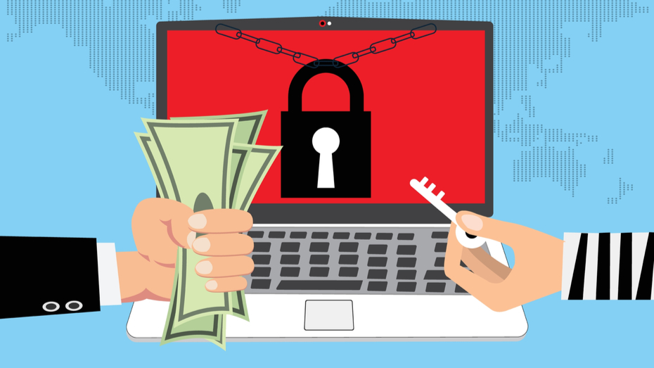
Ransomware
Ransomware is a type of malicious software that locks your computer or encrypts your files, preventing access until you pay a ransom, often demanded in cryptocurrency. It typically infects systems when users open malicious email attachments, click on deceptive links or pop-ups, visit compromised websites, or use infected USB drives or messaging apps. Once activated, ransomware may lock your device or encrypt your data, showing a message demanding payment and threatening to delete or expose your files if the ransom isn’t paid. It is dangerous because it can cause permanent data loss, spread across networks, and fuel more cybercrimes if ransoms are paid. To protect yourself, avoid suspicious links and attachments, keep software updated, use antivirus and firewalls, back up data regularly, and avoid using untrusted USB drives or devices.

Slide 8
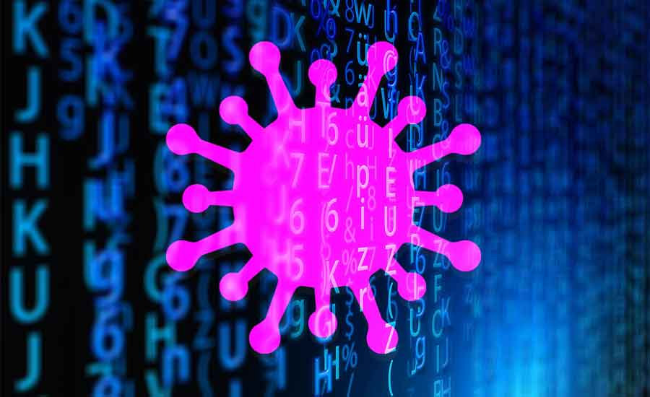
Viruses
It is a type of malware which attach itself and modify the program and software.
When it is executed, it replicates itself by modifying other computer programs and inserting its own code.
When this replication succeeds, the affected areas are then said to be “infected” with a computer virus.
It can damage hardware, software or files.
A common type is the macro virus, which uses application macro languages like Visual Basic to infect documents and templates. Once an infected document is opened, the virus can alter files, add unwanted content, or change how commands work. It can also embed itself into all future documents created with the affected application, making it a persistent threat.

Slide 9

Worms
A computer worm is a self-replicating program that copies itself from one computer to another.
It uses a computer network to send copies of itself to other nodes and do so without any user intervention. It searches for servers with security holes and copies itself.
Unlike a virus, which needs to attach itself to a program, a worm is a standalone program that actively seeks out other machines to infect. Once it infects a machine, it uses that machine to continue spreading to more systems.
Types of worm : Email worm, Internet worm, Instant messaging worm, File sharing network worm etc.

Slide 10

Trojan Horse
A Trojan horse is a type of malware that hides within a legitimate file or program to gain access to your device. Because Trojan malware is delivered inside a legitimate app or file, it’s very difficult to detect. Trojans are used to spy on victims, steal data, infect other programs, and inflict other harm.
Trojans are typically sent by scammers or hackers who use social engineering tactics, like the ones used in phishing attacks. Trojan horse malware appears as a harmless or even helpful file, leading users to install the malware unwittingly on their computers or phones.

Slide 11
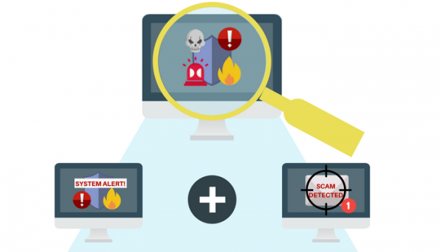
Blended Threat
A blended threat is a powerful and sophisticated type of cyberattack that combines elements of various malicious codes, such as viruses, worms, and Trojan horses, into a single package.
It exploits vulnerabilities in servers and internet systems to initiate and spread attacks across an organization’s devices.
Unlike traditional threats that target specific files, blended threats can simultaneously attack multiple file types (e.g., EXE files, HTML files) and even system registry keys.
They spread using multiple methods, such as email, chat applications, and file-sharing networks, making them highly versatile and dangerous.

Slide 12

Spam
Spam refers to the practice of sending unrequested emails to a large number of people, often used for low-cost commercial advertising, including questionable products, scams, or worthless schemes. While some legitimate organizations use spam for marketing, such as announcing new products to potential customers, it is also a common method to spread harmful malware like worms. Spam fills inboxes with unwanted content, making it harder for users to find important messages and wasting their time and resources. It also imposes financial costs on both users, who may pay for time spent managing spam, and internet service providers, who incur additional costs to handle the high volume of spam traffic, ultimately raising charges for all subscribers.

Slide 13
DDoS Attack
A Distributed Denial-of-Service (DDoS) attack occurs when a malicious hacker takes control of multiple computers over the internet and uses them to flood a target website or server with excessive requests for data.
The goal is to overwhelm the target system by keeping it busy with automated tasks, preventing legitimate users from accessing the site.
It’s like repeatedly dialing a phone number to keep the line busy for everyone else.
Unlike a Denial-of-Service (DoS) attack, which comes from one computer, a DDoS attack involves many devices from multiple locations, making it harder to stop.
The software to launch a DDoS attack is easy to use and often available on hacker websites, allowing attackers to secretly install a small program on numerous computers globally, turning them into "zombies" that carry out the attack.

Slide 14
Rootkit
A rootkit is a set of malicious programs that allows an attacker to gain administrator-level access to a computer without the user’s knowledge.
Once installed, the attacker can control the system, execute files, access logs, monitor user activity, and change settings, all while hiding the rootkit from legitimate system administrators.
Rootkits are often part of a blended threat, which includes a dropper, a loader, and the rootkit itself.
The dropper activates the installation of the rootkit by tricking users into opening infected files or links. Once the rootkit is loaded into the system, it can be very difficult to detect because the operating system itself is compromised.
Symptoms of a rootkit infection may include system freezes, unexpected screen saver changes, disappearing taskbars, or very slow network activity. If a rootkit is detected, the only way to remove it is to reformat the computer’s hard drive, reinstall the operating system, and restore applications, which can result in data loss and significant downtime.

Slide 15
Advanced Persistent Threat
An Advanced Persistent Threat (APT) is a kind of network attack where an intruder gains access to a network and remains undetected for an extended period, often weeks or months, with the intent to steal sensitive data rather than disrupt services.
APT attackers use advanced methods to evade detection, continually rewriting code and employing new advanced techniques.
APTs typically target organizations with valuable information, such as financial institutions, government agencies, and insurance companies.
The attack occurs in five stages:
1. Reconnaissance ( Inspection) :
The attacker gathers information about the target, such as security software and network resources.
2. Incursion ( Attack) :
The attacker next launches incursions to gain access to the network at low level to avoid setting off any alarms or suspicion. Some form of spear phishing may be employed in this phase. After entering to the system, the attacker access the computer resources creating a backdoor bypassing security mechanism.

Slide 16
3. Discovery :
The attacker collects user credentials, particularly administrative ones, and moves through the network, installing more backdoors to maintain access.
4. Capture :
The attacker gains access to unprotected systems and begins stealing data over a long period.
5. Export :
The stolen data is sent back to the attacker’s base for analysis or use in illegal activities.

Slide 17
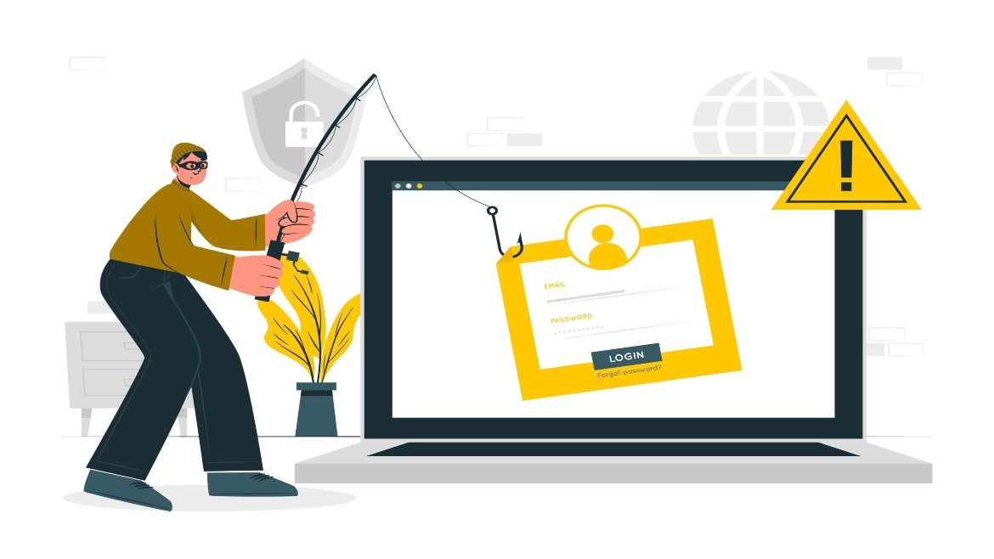
Phishing
Phishing is a type of cyberattack where scammers use fraudulent emails to trick recipients into revealing personal information.
These emails often appear to be from legitimate sources and may warn of negative consequences (such as account suspension) or promise rewards (like a prize).
The email usually asks the recipient to click on a link or open an attachment. The link often leads to a fake website that looks like a legitimate one, where the victim is prompted to enter sensitive data such as passwords, credit card numbers, or other personal details.
In some cases, the email attachment may contain malware that infects the victim's computer when opened.

Slide 18
Spear Phishing
Spear phishing is a targeted version of phishing where attackers send fraudulent emails to specific employees within an organization, often impersonating high-level executives like the CEO or CFO.
The goal is to make the email seem legitimate and trustworthy.
The emails typically direct employees to a fake website, where they are prompted to enter sensitive personal information, such as passwords, Social Security numbers, or other confidential details.
Unlike regular phishing, which is broad and sent to many people, spear phishing is more precise, focusing on particular individuals.

Slide 19
Smishing and Vishing
Smishing and vishing are variations of phishing that use different methods to trick people into revealing personal information.
Smishing involves text messages (SMS), where victims receive messages that look legitimate, urging them to call a number or visit a website, often claiming there is an urgent issue with their bank account or credit card. These messages are designed to steal sensitive information like bank account numbers or credit card details. Sometimes, visiting the fake website can lead to malicious software being downloaded onto the victim's phone, giving criminals access to stored data.
Vishing (voice phishing) is similar, but it uses voice calls or voicemail messages. Victims receive a recorded message or call telling them to dial a number or visit a website, often claiming that their ATM card has been deactivated, prompting them to enter their card number and PIN. This information is then stolen and used to withdraw money or commit fraud.

Slide 20
Cyberterrorism
Cyberterrorism refers to the use of information technology by terrorists to carry out attacks that disrupt or damage critical national infrastructure, such as energy, transportation, financial systems, law enforcement, and emergency services.
The goal of cyberterrorism is typically to create fear, chaos, or financial loss while achieving political, religious, or ideological objectives.
It involves targeting government systems, private sector networks, or essential services with the intent to cause widespread disruption or harm.
As cyberterrorism continues to grow, it becomes an increasing concern for countries and organizations worldwide, as it poses significant risks to national security and public safety.

Slide 21
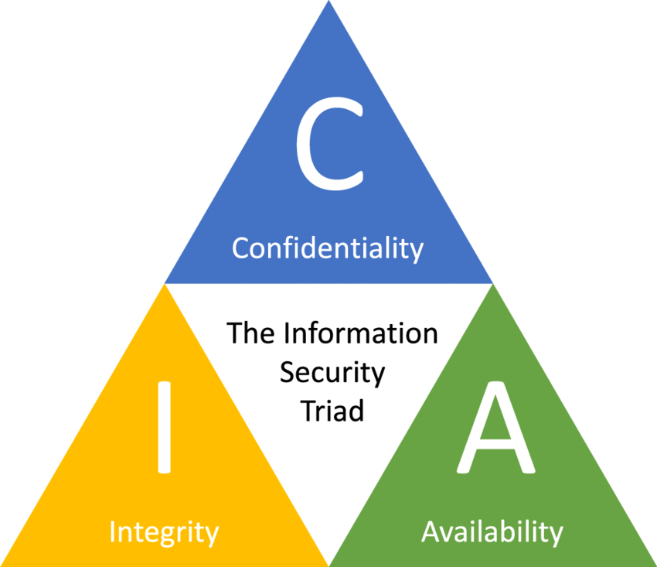
CIA-Triad
The IT security practices of organizations worldwide are focused on ensuring :
Confidentiality,
Integrity, and
Availability

Slide 22
1. Confidentiality:
The information cannot be understood by anyone for whom it was unintended.
This term covers two related concepts:
Data confidentiality: Assures that private or confidential information is not made available or disclosed to unauthorized individuals.
Privacy: Assures that individuals control or influence what information related to them may be collected and stored and by whom and to whom that information may be disclosed.

Slide 23
2. Integrity :
This objective is concerned with maintaining the accuracy, consistency, and trustworthiness of data and systems.
It involves two main aspects:
Data Integrity: Ensures that information remains unchanged and uncorrupted during storage, processing, or transmission. Any alterations to data should occur only through authorized means, preventing unauthorized modifications or tampering.
System Integrity: Guarantees that a system functions as intended without unauthorized interference or manipulation. It ensures that the system's components, including hardware, software, and firmware, operate in a secure and reliable manner, free from deliberate unauthorized actions.

Slide 24
3. Availability:
This objective focuses on ensuring that computer systems and services are accessible and usable by authorized users when needed. It aims to prevent disruptions or denial of service that could prevent legitimate users' ability to access resources or perform tasks.
By addressing these objectives—confidentiality, integrity, and availability—organizations can establish a comprehensive approach to computer security, safeguarding their information systems and resources from various threats and vulnerabilities.
These three concepts form what is often referred to as the CIA triad. The three concepts embody the fundamental security objectives for both data and for information and computing services.

Slide 25
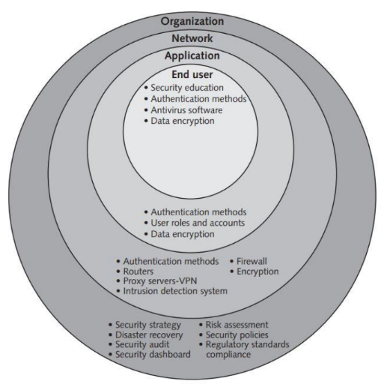
Implementing CIA
No organization can be completely safe from attacks, but the best way to prevent security incidents is by using layered security. Implementing security with multiple layer with multiple defenses will be the safe because if one layer fails, another is there to stop the attacker.
Here the goal is to make it so hard to break in that attackers either give up or are caught before causing major harm. To achieve this, security must be carefully planned, designed, tested, and updated at all levels- organization, network, applications, and users – to protect confidentiality, integrity, and availability.

Slide 26
Implementing CIA at Organizational Level
Implementing CIA at the organization level involves creating a strong security foundation through strategies, policies, and tools to protect against threats and ensure business continuity.
1. Security Strategy :
Develop a risk-based plan to minimize the impact of security incidents. This includes risk assessments, disaster recovery plans, and periodic audits to ensure policies are effective and up to date.
2. Risk Assessment :
Identify critical IT assets, assess threats, their likelihood, and impact, and determine how to mitigate them cost-effectively. Focus on high-risk threats with severe impacts.
3. Disaster Recovery :
Prepare a plan to recover critical systems, data, and operations after disasters (natural or manmade) to keep essential business processes running smoothly.

Slide 27
Implementing CIA at Organizational Level
4. Security Policies :
Create rules to guide employees on proper security practices, such as acceptable use, password protection, and remote access. Automate enforcement where possible.
5. Security Audits :
Regularly evaluate compliance with security policies, test safeguards, and address vulnerabilities. Use penetration testing to identify weak spots.
6. Regulatory Compliance :
Follow external standards and regulations alongside internal policies to meet legal and industry requirements.
7. Security Dashboard :
Use software to monitor threats, compliance, and incidents in real time, simplifying management and enabling quick responses.

Slide 28
Implementing CIA at Network Level
Implementing CIA triad at network level ensures that the network and its data remain safe from unauthorized access, misuse, or disruption. To implement CIA at network level , organizations use a combination of tools and techniques to ensure Confidentiality, Integrity, and Availability of their data and systems.
1. Authentication methods :
Authentication methods are used to confirm that only the right people can access a network. This is done by requiring users to prove their identity using methods like passwords, smart cards, or biometrics (such as fingerprints or face scans). For added security, many systems now use two-factor authentication (2FA), which combines something you know (like a password) with something you have (like a code sent to your phone) or something you are (like a fingerprint). These methods ensure that unauthorized users cannot access sensitive data, keeping the network secure.

Slide 29
2. Firewalls :
Firewalls act as a protective barrier between an organization’s internal network and the Internet. They monitor and control incoming and outgoing network traffic based on predefined security rules. Firewalls block unauthorized access while allowing legitimate communication, ensuring that sensitive data stays protected. They can also restrict employees from accessing inappropriate websites and prevent harmful activities like downloading malicious files. Advanced firewalls, called next-generation firewalls (NGFWs), inspect data in greater detail to detect and block threats like viruses, malware, or hacking attempts, making them essential for network security.
3. Encryption :
Encryption is a process that secures data by converting it into a coded format (ciphertext) that only authorized parties can understand. It protects sensitive information like passwords, financial data, and personal details during online transactions or data sharing. Two types of encryption methods are used: symmetric encryption, where the same key is used to encrypt and decrypt data, and asymmetric encryption, which uses one key for encryption and another for decryption. Popular encryption techniques include AES for symmetric encryption and RSA for asymmetric encryption. Encryption ensures that even if unauthorized users access the data, they cannot read it without the encryption key.

Slide 30
4. Routers :
Routers are devices that direct data traffic between different networks, ensuring that information reaches its intended destination efficiently and securely. They play a vital role in network security by filtering incoming and outgoing data based on predefined rules, blocking unauthorized access, and preventing malicious traffic. Many modern routers include built-in firewalls and encryption features to enhance security. By managing data flow and maintaining network boundaries, routers help protect sensitive information and keep networks secure from external threats.
5. Proxy Servers and Virtual Private Networks (VPNs) :
Proxy Servers and Virtual Private Networks (VPNs) enhance network security and privacy by managing and securing online connections. A proxy server acts as a middleman between a user's device and the internet, hiding the user's IP address and restricting access to certain websites. It also keeps logs of activities, helping organizations monitor and control internet usage. A VPN, on the other hand, creates a secure, encrypted connection over the internet, allowing users to access private networks safely, even from public Wi-Fi. This protects sensitive data from eavesdropping and ensures safe remote access to organizational resources. Together, proxies and VPNs provide layers of protection for online activities and data.

Slide 31
6. Intrusion Detection Systems :
Intrusion Detection Systems (IDS) monitor network traffic and system activities to identify suspicious behavior or potential security breaches. They act like a security guard, watching for unusual activities such as repeated login failures, unauthorized access attempts, or unexpected data transfers. There are two main types of IDS: knowledge-based IDS, which looks for known attack patterns, and behavior-based IDS, which detects deviations from normal behavior. When a threat is detected, the IDS alerts administrators so they can respond quickly and prevent damage, ensuring the integrity and availability of the network.

Slide 32
Implementing CIA at The Application Level
Implementing CIA at the application level involves measures to ensure confidentiality, integrity, and availability of data and functionality in software applications. It includes three key components:
1. Authentication methods :
This verifies the identity of users accessing the application. Common methods include single-factor authentication (username and password) and two-factor authentication, which requires two credentials, such as a password (something you know) and a physical token or biometric scan (something you have or are). For example, withdrawing money from an ATM requires a bank card and a PIN.
2. User Roles and Accounts :
Applications should define roles and permissions to restrict user access based on their responsibilities. For instance, employees in finance should access financial records, while HR personnel manage employee data. Role-based access controls ensure that users can only perform tasks relevant to their roles, preventing unauthorized actions within the application.

Slide 33
3. Data Encryption :
Sensitive application data, such as those in ERP (Enterprise Resource Planning), CRM, (Customer Relationship Management) or PLM (Product Lifecycle Management) systems, should be encrypted. Encryption ensures that even if unauthorized users gain access, they cannot understand the data without the decryption key, safeguarding confidential information across storage devices, cloud services, and third-party locations.

Slide 34
Implementing CIA at The End-User Level
Implementing CIA at the End-User Level focuses on protecting the individual user, often considered the weakest link in an organization's security chain. Here’s how the CIA (Confidentiality, Integrity, and Availability) principles can be implemented at this level:
1. Security Education :
It's essential to educate users about security policies and make them aware of their responsibilities in protecting organizational data. Regular security training can help users understand their critical role in safeguarding information. For instance, they should guard their passwords, not share them with others, use access controls, report unusual activities, and protect portable devices. By fostering a culture of security awareness, the organization can reduce the risk of security breaches caused by human error.

Slide 35
2. Authentication Methods :
End users should implement strong authentication methods, such as passcodes or biometrics (e.g., fingerprint or facial recognition) to prevent unauthorized access to their devices and accounts. Using multifactor authentication (MFA) further strengthens security by requiring multiple forms of identification, ensuring that even if one factor (like a password) is compromised, the system remains protected.
3. Antivirus Software :
Antivirus software is essential for detecting and preventing malicious software from compromising a user’s device. It scans the device for known virus signatures and can take actions like cleaning, deleting, or quarantining infected files. Antivirus software should be updated regularly to stay effective against new threats. Additionally, continuous monitoring and scanning help ensure the device remains free from harmful code that could jeopardize its integrity and the organization’s network.

Slide 36
4. Data Encryption :
Data encryption is a crucial step in protecting sensitive information, especially if a device is lost or stolen. Full disk encryption ensures that even if someone physically accesses the device or storage, they cannot read the data without the encryption key. This adds an extra layer of protection to sensitive files and prevents unauthorized access to confidential information.

Slide 37
Response to Cyberattack
Cyberattacks can disrupt operations, compromise data, and damage reputation.
The response to a cyber attack refers to the actions an organization takes after identifying that its systems, data, or network has been compromised.
These actions aim to control the situation, minimize damage, and recover normal operations as quickly and securely as possible.
A well-prepared and executed response can significantly reduce the impact of a cyber attack.
Some of the activities performed in case of cyberattack are:
Incident notification
Protection of evidence and activity logs
Incident containment
Eradication
Incident follow-up
Using an MSSP (managed security service provider)
Computer Forensics

Slide 38
1. Incident Notification :
It is the process of informing the right people about a security incident or cyber attack.
It involves deciding who to notify, what information to share, and when to share it. For example, if a company's database is hacked, the IT team must inform management, affected customers, and legal authorities while ensuring sensitive details are not leaked to the public.
Clear communication helps control the situation, keeps stakeholders informed, and ensures compliance with legal requirements like data breach notification laws. For instance, notifying customers promptly about compromised credit card details allows them to take precautions like blocking their cards.

Slide 39
2. Protection of Evidence and Logs :
It involves preserving all records and data related to a cyberattack to ensure they can be used for investigation and legal purposes.
This includes capturing system events, recording actions taken during incident response, and documenting external communications in a secure log.
For example, if a malware attack occurs, IT staff should save logs of affected systems, create forensic disk images of compromised machines, and securely store them as evidence. Proper documentation helps identify the source of the attack, aids in prosecution, and provides insights to prevent similar incidents in the future.
3. Incident Containment :
Incident Containment refers to the process of limiting the impact of a cyberattack to prevent further damage to an organization's systems and data.
This involves isolating affected systems, disconnecting compromised networks, and taking immediate steps to stop the spread of the attack.
For example, if a ransomware attack is detected on a server, the IT team might disconnect the server from the network to stop the malware from encrypting files on other devices. The containment process is guided by a predefined response plan, which ensures quick decision-making and minimizes disruption to critical operations.

Slide 40
4. Eradication :
Eradication is the process of removing the cause of a cyberattack and eliminating any traces of the threat from affected systems.
This step ensures that the organization’s IT environment is clean and secure before resuming normal operations.
It involves identifying and deleting malicious software, patching vulnerabilities, and restoring systems from clean backups if necessary.
5. Incident Follow-Up:
Incident Follow-Up is the final step in responding to a cyberattack, where the organization evaluates the incident to prevent similar occurrences in the future.
This involves reviewing the attack's root cause, assessing the effectiveness of the response, and identifying any weaknesses in the security measures.
The follow-up often includes creating a formal incident report detailing what happened, how the organization responded, the impact of the incident, and recommendations for improvement.

Slide 41
6. Managed Security Service Providers (MSSPs) :
MSSPs are external companies that specialize in monitoring, managing, and maintaining an organization’s cybersecurity.
They help businesses handle complex security tasks such as threat detection, vulnerability scanning, and compliance with security regulations, which may be challenging for in-house teams. MSSPs provide services like firewall management, antivirus updates, intrusion detection, and incident response.
7. Computer Forensics :
Computer Forensics is the practice of investigating and analyzing computer systems, networks, and digital storage devices to collect, preserve, and interpret data for legal or investigative purposes. It ensures that the data remains intact and admissible in court. This field combines elements of computer science and law to uncover digital evidence in cases of cybercrime, fraud, data breaches, or other security incidents.
For example, if a company experiences a data breach, a forensic investigator might examine hard drives, analyze network logs, and recover deleted files to identify the source of the attack and the extent of the damage. Tools like Forensic Toolkit (FTK) and EnCase are commonly used for tasks like recovering encrypted files or analyzing email trails. Properly conducted computer forensics is critical for resolving disputes, prosecuting criminals, and preventing future incidents.

Slide 42
Cyber Law
Cyber law, also known as cybercrime law, is legislation focused on the acceptable behavioral use of technology including computer hardware and software, the internet, and networks.
Cyber law helps protect users from harm by enabling the investigation and prosecution of online criminal activity.
It applies to the actions of individuals, groups, the public, government, and private organizations.
Cyber law is the part of the overall legal system that deals with the Internet, cyberspace, and their respective legal issues. Cyber law covers a fairly broad area, encompassing several subtopics including freedom of expression, access to and usage of the Internet, and online privacy.
Generically, cyber law is referred to as the Law of the Internet.
In business, cyber law protects companies from unlawful access and theft of their intellectual property.

Slide 43
Importance of Cyber Law
Cyber law plays a crucial role in protecting individuals, organizations, and governments from threats and malicious activities in the digital world. It ensures that cyberspace remains a safe and reliable environment for communication, business, and information exchange.
The importance of cyber law are-
It dictates all actions and reactions in Cyberspace.
All online transactions are ensured to be safe and protected.
All online activities are under watch by the Cyber ​​law officials.
Security for all data and property of individuals, organizations, and government.
Helps curb illegal cyber activities.
All actions and reactions implemented on any cyberspace have some legal angle associated with it.
Keeps track of all electronic records.
Helps to establish electronic governance.

Slide 44
Punishments
The increase in Internet traffic has led to a higher proportion of legal issues worldwide. Because Cyber laws vary by jurisdiction and country, enforcement is challenging, and restitution ranges from fines to imprisonment.
There are different forms of punishment depending on the type of cyber law you broke, who you offended, where you broke the law, and where you live. In many situations, breaking the rules on a website result in your account becoming suspended or banned and your IP addressed blocked.
If you've committed a more serious offense such as hacking, attacking another person or website, or causing another person or company distress, additional action may be taken against you.

Slide 45
Types of Cyber Law
Cyber law includes various areas of digital and online activity, addressing legal issues to protect individuals, organizations, and governments.
1. Copyright Law :
Protects the intellectual property of individuals and companies, ensuring they can benefit from their creative works.
Prevents unauthorized use, reproduction, or distribution of copyrighted material online.
2. Defamation Law :
Deals with false public statements on the internet that harm an individual’s or organization’s reputation.
Addresses issues like fake reviews or defamatory posts and provides legal recourse.
3. Fraud Prevention :
Focuses on protecting users from online fraud such as credit card theft, identity theft, phishing, and other monetary crimes.
Criminal charges and civil actions can be taken against perpetrators.

Slide 46
Types of Cyber Law
4. Harassment and Stalking Laws :
Prevents online harassment, including threatening statements, cyberbullying, and stalking.
Protects individuals from repeated offensive actions that violate their safety and peace.
5. Freedom of Speech Regulations :
Ensures that online freedom of speech is exercised responsibly.
Limits speech that promotes immorality, hate, or violence, while safeguarding individuals' rights to express themselves within legal boundaries.
6. Trade Secrets Protection :
Secures proprietary information like algorithms, designs, or business strategies from being stolen or misused by competitors.
Enables organizations to take legal action against those who violate their trade secrets.

Slide 47
Types of Cyber Law
7. Contracts and Employment Laws :
Governs online agreements, such as terms and conditions for website use or software downloads.
Ensures the privacy and rights of users and employees in digital environments.

